Slide 1
Inverted Index and Boolean Queries
Ramesh Ragala
Assistant Professor (Senior)
VIT Chennai

Slide 2
Introduction to IR
Due to its convenience and the richness of information on the Web
searching the Web is increasingly becoming the dominant information seeking method.
Web search has its root in information retrieval.
Information Retrieval → a field of study that helps the user find needed information from a large collection of text documents.
The documents are Web pages on web.
Retrieving information → finding a set of documents that is relevant to the user query
A ranking of the set of documents according to their relevance scores to the query.
The query format is a list of keywords. (terms)
SQL is different than text retrieval query.(unstructured text)
Notes:
First, let's define NER!
go through pages, recognize the names of things: "Bill MacCartney", "Stanford University"
the people who came up with this task had a rather precise, philosophically motivated meaning in mind
entity: a discrete, actual thing: Bill MacCartney, but not calcium carbonate or Tuesday or Viagra
named entity: an entity with a name, in a philosophical, Kripke-like sense
(this water bottle is an entity, but not a NAMED entity)
but in practice the definition has been expanded quite a bit in later work
we routinely include dates & times, proteins, drug names
but still, loosely, things that have a name
but NOT references to entities which are not names: "this university", "it”
first task in NER: identifying occurrences of named entities
looking for capital letters is a really good clue! at least in English! but not so much in Hebrew, Chinese, ... non-Latinate alphabets also doesn't really work in German -- all nouns are capitalized!
so that's a pretty useful base-level task -- widely deployed and used
you've probably seen web pages that do this
e.g. financial web sites often mark up stock symbols, names of companies
Microsoft has done work with this, smart tags, entities tagged with metadata
Reuters has web service OpenCalais, you send them docs, they send back NER markup

Slide 3
Introduction to IR
Web search is single most important application in IR.
Web search also helped IR.
Efficiency is the main issue in web search, but it is only the secondary in traditional IR. → documents in IR are not very large.
The number of pages on web is huge.
Web users also demands very fast responses.
Web pages are different from conventional text documents → hyperlinks, anchor texts
Web page has different fields like title, metadata, body, etc..
Spamming is main concern issue on web.
Notes:
First, let's define NER!
go through pages, recognize the names of things: "Bill MacCartney", "Stanford University"
the people who came up with this task had a rather precise, philosophically motivated meaning in mind
entity: a discrete, actual thing: Bill MacCartney, but not calcium carbonate or Tuesday or Viagra
named entity: an entity with a name, in a philosophical, Kripke-like sense
(this water bottle is an entity, but not a NAMED entity)
but in practice the definition has been expanded quite a bit in later work
we routinely include dates & times, proteins, drug names
but still, loosely, things that have a name
but NOT references to entities which are not names: "this university", "it”
first task in NER: identifying occurrences of named entities
looking for capital letters is a really good clue! at least in English! but not so much in Hebrew, Chinese, ... non-Latinate alphabets also doesn't really work in German -- all nouns are capitalized!
so that's a pretty useful base-level task -- widely deployed and used
you've probably seen web pages that do this
e.g. financial web sites often mark up stock symbols, names of companies
Microsoft has done work with this, smart tags, entities tagged with metadata
Reuters has web service OpenCalais, you send them docs, they send back NER markup

Slide 4
Introduction to IR
Information retrieval (IR) is finding material (usually documents) of an unstructured nature (usually text) that satisfies an information need from within large collections (usually stored on computers).
Information retrieval systems can also be distinguished by the scale at which they operate
Web search
Search ground are billions of documents on millions of computers
issues: spidering; efficient indexing and search; malicious manipulation to boost search engine rankings
Link analysis
Personal Information Retrieval
e.g., Mac OS X Spotlight; Windows’ Instant Search
Issues: different file types; maintenance-free, lightweight to run in background
Enterprise, Institutional and Domain-specific search
e.g company’s documentation, patents, research articles
often domain-specific
Centralized storage; dedicated machines for search
Most prevalent IR evaluation scenario: US intelligence analyst’s searches
grepping: The simplest form of document retrieval is for a computer to do this sort of linear scan through documents.
Notes:
First, let's define NER!
go through pages, recognize the names of things: "Bill MacCartney", "Stanford University"
the people who came up with this task had a rather precise, philosophically motivated meaning in mind
entity: a discrete, actual thing: Bill MacCartney, but not calcium carbonate or Tuesday or Viagra
named entity: an entity with a name, in a philosophical, Kripke-like sense
(this water bottle is an entity, but not a NAMED entity)
but in practice the definition has been expanded quite a bit in later work
we routinely include dates & times, proteins, drug names
but still, loosely, things that have a name
but NOT references to entities which are not names: "this university", "it”
first task in NER: identifying occurrences of named entities
looking for capital letters is a really good clue! at least in English! but not so much in Hebrew, Chinese, ... non-Latinate alphabets also doesn't really work in German -- all nouns are capitalized!
so that's a pretty useful base-level task -- widely deployed and used
you've probably seen web pages that do this
e.g. financial web sites often mark up stock symbols, names of companies
Microsoft has done work with this, smart tags, entities tagged with metadata
Reuters has web service OpenCalais, you send them docs, they send back NER markup

Slide 5
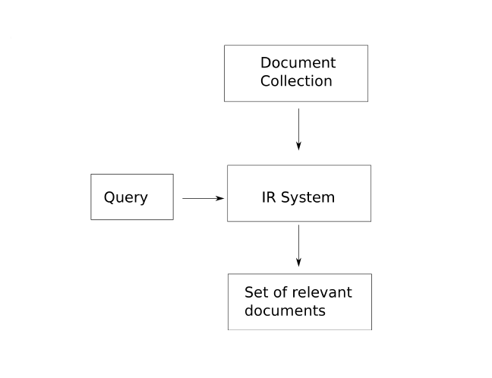
Introduction to IR
Notes:
First, let's define NER!
go through pages, recognize the names of things: "Bill MacCartney", "Stanford University"
the people who came up with this task had a rather precise, philosophically motivated meaning in mind
entity: a discrete, actual thing: Bill MacCartney, but not calcium carbonate or Tuesday or Viagra
named entity: an entity with a name, in a philosophical, Kripke-like sense
(this water bottle is an entity, but not a NAMED entity)
but in practice the definition has been expanded quite a bit in later work
we routinely include dates & times, proteins, drug names
but still, loosely, things that have a name
but NOT references to entities which are not names: "this university", "it”
first task in NER: identifying occurrences of named entities
looking for capital letters is a really good clue! at least in English! but not so much in Hebrew, Chinese, ... non-Latinate alphabets also doesn't really work in German -- all nouns are capitalized!
so that's a pretty useful base-level task -- widely deployed and used
you've probably seen web pages that do this
e.g. financial web sites often mark up stock symbols, names of companies
Microsoft has done work with this, smart tags, entities tagged with metadata
Reuters has web service OpenCalais, you send them docs, they send back NER markup

Slide 6
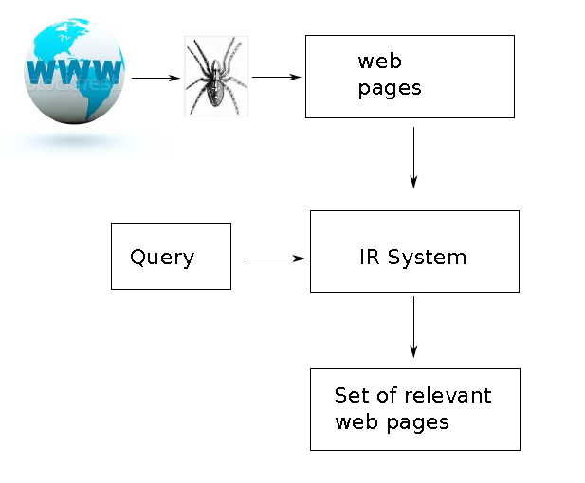
Introduction to IR
Notes:
First, let's define NER!
go through pages, recognize the names of things: "Bill MacCartney", "Stanford University"
the people who came up with this task had a rather precise, philosophically motivated meaning in mind
entity: a discrete, actual thing: Bill MacCartney, but not calcium carbonate or Tuesday or Viagra
named entity: an entity with a name, in a philosophical, Kripke-like sense
(this water bottle is an entity, but not a NAMED entity)
but in practice the definition has been expanded quite a bit in later work
we routinely include dates & times, proteins, drug names
but still, loosely, things that have a name
but NOT references to entities which are not names: "this university", "it”
first task in NER: identifying occurrences of named entities
looking for capital letters is a really good clue! at least in English! but not so much in Hebrew, Chinese, ... non-Latinate alphabets also doesn't really work in German -- all nouns are capitalized!
so that's a pretty useful base-level task -- widely deployed and used
you've probably seen web pages that do this
e.g. financial web sites often mark up stock symbols, names of companies
Microsoft has done work with this, smart tags, entities tagged with metadata
Reuters has web service OpenCalais, you send them docs, they send back NER markup

Slide 7
Introduction to Boolean Retrieval
In the Boolean retrieval model we can pose any query in the form of a Boolean expression of terms
i.e., one in which terms are combined with the operators and, or, and not.
Example: Shakespeare book collection
Retrieval:
Which plays of Shakespeare contain the words Brutus and Caesar, but not Calpurnia?
Solution:
linear scan through all text – “grepping”
It works fine → 1M
Notes:
First, let's define NER!
go through pages, recognize the names of things: "Bill MacCartney", "Stanford University"
the people who came up with this task had a rather precise, philosophically motivated meaning in mind
entity: a discrete, actual thing: Bill MacCartney, but not calcium carbonate or Tuesday or Viagra
named entity: an entity with a name, in a philosophical, Kripke-like sense
(this water bottle is an entity, but not a NAMED entity)
but in practice the definition has been expanded quite a bit in later work
we routinely include dates & times, proteins, drug names
but still, loosely, things that have a name
but NOT references to entities which are not names: "this university", "it”
first task in NER: identifying occurrences of named entities
looking for capital letters is a really good clue! at least in English! but not so much in Hebrew, Chinese, ... non-Latinate alphabets also doesn't really work in German -- all nouns are capitalized!
so that's a pretty useful base-level task -- widely deployed and used
you've probably seen web pages that do this
e.g. financial web sites often mark up stock symbols, names of companies
Microsoft has done work with this, smart tags, entities tagged with metadata
Reuters has web service OpenCalais, you send them docs, they send back NER markup

Slide 8
Introduction to Boolean Retrieval
But in the general case, with much larger text collections, we need to index.
Indexing is an offline operation that collects data about which words occur in a text, so that at search time you only have to access the precompiled index.
Notes:
First, let's define NER!
go through pages, recognize the names of things: "Bill MacCartney", "Stanford University"
the people who came up with this task had a rather precise, philosophically motivated meaning in mind
entity: a discrete, actual thing: Bill MacCartney, but not calcium carbonate or Tuesday or Viagra
named entity: an entity with a name, in a philosophical, Kripke-like sense
(this water bottle is an entity, but not a NAMED entity)
but in practice the definition has been expanded quite a bit in later work
we routinely include dates & times, proteins, drug names
but still, loosely, things that have a name
but NOT references to entities which are not names: "this university", "it”
first task in NER: identifying occurrences of named entities
looking for capital letters is a really good clue! at least in English! but not so much in Hebrew, Chinese, ... non-Latinate alphabets also doesn't really work in German -- all nouns are capitalized!
so that's a pretty useful base-level task -- widely deployed and used
you've probably seen web pages that do this
e.g. financial web sites often mark up stock symbols, names of companies
Microsoft has done work with this, smart tags, entities tagged with metadata
Reuters has web service OpenCalais, you send them docs, they send back NER markup

Slide 9
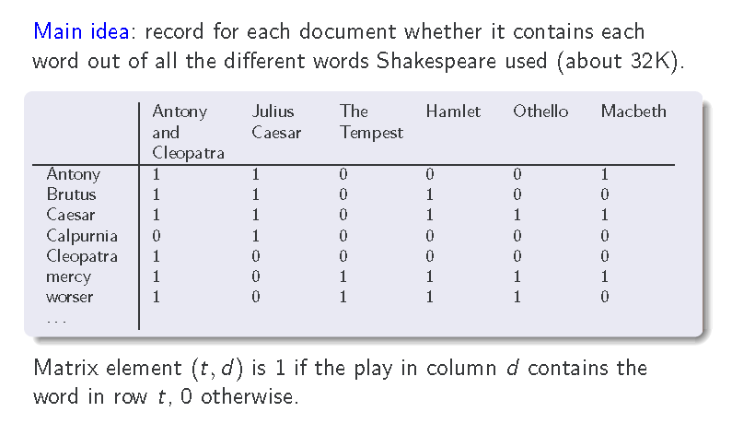
The term-document incidence matrix
Notes:
First, let's define NER!
go through pages, recognize the names of things: "Bill MacCartney", "Stanford University"
the people who came up with this task had a rather precise, philosophically motivated meaning in mind
entity: a discrete, actual thing: Bill MacCartney, but not calcium carbonate or Tuesday or Viagra
named entity: an entity with a name, in a philosophical, Kripke-like sense
(this water bottle is an entity, but not a NAMED entity)
but in practice the definition has been expanded quite a bit in later work
we routinely include dates & times, proteins, drug names
but still, loosely, things that have a name
but NOT references to entities which are not names: "this university", "it”
first task in NER: identifying occurrences of named entities
looking for capital letters is a really good clue! at least in English! but not so much in Hebrew, Chinese, ... non-Latinate alphabets also doesn't really work in German -- all nouns are capitalized!
so that's a pretty useful base-level task -- widely deployed and used
you've probably seen web pages that do this
e.g. financial web sites often mark up stock symbols, names of companies
Microsoft has done work with this, smart tags, entities tagged with metadata
Reuters has web service OpenCalais, you send them docs, they send back NER markup

Slide 10
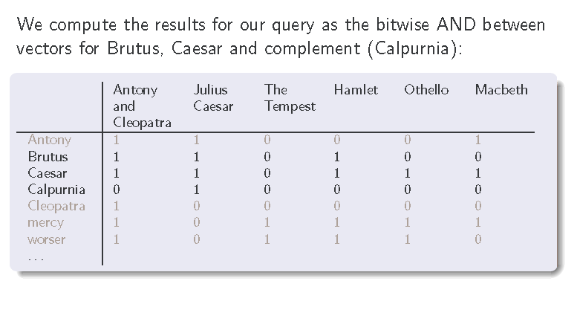
The term-document incidence matrix
Query:
“Brutus AND Caesar AND NOT Calpunia”
Notes:
First, let's define NER!
go through pages, recognize the names of things: "Bill MacCartney", "Stanford University"
the people who came up with this task had a rather precise, philosophically motivated meaning in mind
entity: a discrete, actual thing: Bill MacCartney, but not calcium carbonate or Tuesday or Viagra
named entity: an entity with a name, in a philosophical, Kripke-like sense
(this water bottle is an entity, but not a NAMED entity)
but in practice the definition has been expanded quite a bit in later work
we routinely include dates & times, proteins, drug names
but still, loosely, things that have a name
but NOT references to entities which are not names: "this university", "it”
first task in NER: identifying occurrences of named entities
looking for capital letters is a really good clue! at least in English! but not so much in Hebrew, Chinese, ... non-Latinate alphabets also doesn't really work in German -- all nouns are capitalized!
so that's a pretty useful base-level task -- widely deployed and used
you've probably seen web pages that do this
e.g. financial web sites often mark up stock symbols, names of companies
Microsoft has done work with this, smart tags, entities tagged with metadata
Reuters has web service OpenCalais, you send them docs, they send back NER markup

Slide 11
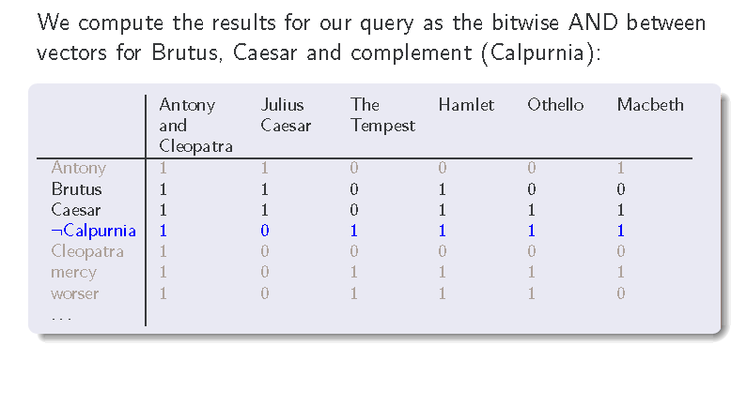
The term-document incidence matrix
Query:
“Brutus AND Caesar AND NOT Calpunia”
Notes:
First, let's define NER!
go through pages, recognize the names of things: "Bill MacCartney", "Stanford University"
the people who came up with this task had a rather precise, philosophically motivated meaning in mind
entity: a discrete, actual thing: Bill MacCartney, but not calcium carbonate or Tuesday or Viagra
named entity: an entity with a name, in a philosophical, Kripke-like sense
(this water bottle is an entity, but not a NAMED entity)
but in practice the definition has been expanded quite a bit in later work
we routinely include dates & times, proteins, drug names
but still, loosely, things that have a name
but NOT references to entities which are not names: "this university", "it”
first task in NER: identifying occurrences of named entities
looking for capital letters is a really good clue! at least in English! but not so much in Hebrew, Chinese, ... non-Latinate alphabets also doesn't really work in German -- all nouns are capitalized!
so that's a pretty useful base-level task -- widely deployed and used
you've probably seen web pages that do this
e.g. financial web sites often mark up stock symbols, names of companies
Microsoft has done work with this, smart tags, entities tagged with metadata
Reuters has web service OpenCalais, you send them docs, they send back NER markup

Slide 12
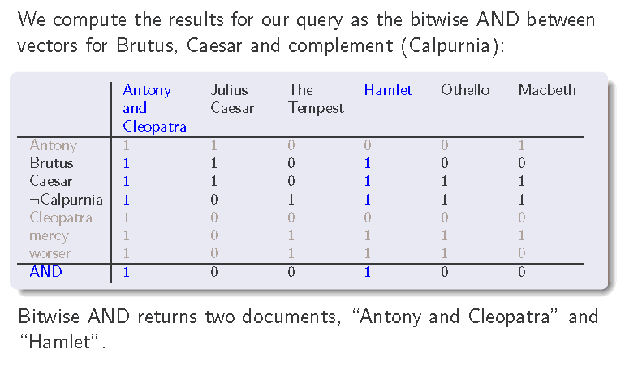
The term-document incidence matrix
Query:
“Brutus AND Caesar AND NOT Calpunia”
Notes:
First, let's define NER!
go through pages, recognize the names of things: "Bill MacCartney", "Stanford University"
the people who came up with this task had a rather precise, philosophically motivated meaning in mind
entity: a discrete, actual thing: Bill MacCartney, but not calcium carbonate or Tuesday or Viagra
named entity: an entity with a name, in a philosophical, Kripke-like sense
(this water bottle is an entity, but not a NAMED entity)
but in practice the definition has been expanded quite a bit in later work
we routinely include dates & times, proteins, drug names
but still, loosely, things that have a name
but NOT references to entities which are not names: "this university", "it”
first task in NER: identifying occurrences of named entities
looking for capital letters is a really good clue! at least in English! but not so much in Hebrew, Chinese, ... non-Latinate alphabets also doesn't really work in German -- all nouns are capitalized!
so that's a pretty useful base-level task -- widely deployed and used
you've probably seen web pages that do this
e.g. financial web sites often mark up stock symbols, names of companies
Microsoft has done work with this, smart tags, entities tagged with metadata
Reuters has web service OpenCalais, you send them docs, they send back NER markup

Slide 13
Introduction to Boolean Model
Bigger Collection:
Consider N=10⁶ documents, each with about 1000 tokens.
10⁹ tokens at avg 6 Bytes per token → 6GB
Assume there are M=500,000 distinct terms in the collection
Size of incidence matrix is then 500,000 ×10⁶.
Half a trillion 0s and 1s
Build Term-Document incidence Matrix is difficult:
It is very sparse
Contains no more than one billion 1s.
Solution:
only represent the things that do occur
Term-document matrix has other disadvantages, such as lack of support for more complex query operators
Notes:
First, let's define NER!
go through pages, recognize the names of things: "Bill MacCartney", "Stanford University"
the people who came up with this task had a rather precise, philosophically motivated meaning in mind
entity: a discrete, actual thing: Bill MacCartney, but not calcium carbonate or Tuesday or Viagra
named entity: an entity with a name, in a philosophical, Kripke-like sense
(this water bottle is an entity, but not a NAMED entity)
but in practice the definition has been expanded quite a bit in later work
we routinely include dates & times, proteins, drug names
but still, loosely, things that have a name
but NOT references to entities which are not names: "this university", "it”
first task in NER: identifying occurrences of named entities
looking for capital letters is a really good clue! at least in English! but not so much in Hebrew, Chinese, ... non-Latinate alphabets also doesn't really work in German -- all nouns are capitalized!
so that's a pretty useful base-level task -- widely deployed and used
you've probably seen web pages that do this
e.g. financial web sites often mark up stock symbols, names of companies
Microsoft has done work with this, smart tags, entities tagged with metadata
Reuters has web service OpenCalais, you send them docs, they send back NER markup

Slide 14
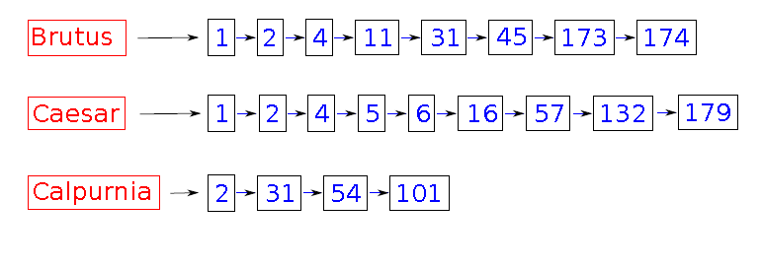
Introduction to Boolean Model
The inverted index consists of
a dictionary of terms (also: lexicon, vocabulary)
and a postings list for each term, i.e., a list that records which documents the term occurs in.
Notes:
First, let's define NER!
go through pages, recognize the names of things: "Bill MacCartney", "Stanford University"
the people who came up with this task had a rather precise, philosophically motivated meaning in mind
entity: a discrete, actual thing: Bill MacCartney, but not calcium carbonate or Tuesday or Viagra
named entity: an entity with a name, in a philosophical, Kripke-like sense
(this water bottle is an entity, but not a NAMED entity)
but in practice the definition has been expanded quite a bit in later work
we routinely include dates & times, proteins, drug names
but still, loosely, things that have a name
but NOT references to entities which are not names: "this university", "it”
first task in NER: identifying occurrences of named entities
looking for capital letters is a really good clue! at least in English! but not so much in Hebrew, Chinese, ... non-Latinate alphabets also doesn't really work in German -- all nouns are capitalized!
so that's a pretty useful base-level task -- widely deployed and used
you've probably seen web pages that do this
e.g. financial web sites often mark up stock symbols, names of companies
Microsoft has done work with this, smart tags, entities tagged with metadata
Reuters has web service OpenCalais, you send them docs, they send back NER markup

Slide 15
Introduction to Boolean Model
Processing Boolean Queries:
Boolean Query: Brutus AND Calpurnia
Locate Brutus in the Dictionary
Retrieve its posting
Locate Calpurnia in the Dictionary
Retrieve its posting
Intersect the two postings list.
Notes:
First, let's define NER!
go through pages, recognize the names of things: "Bill MacCartney", "Stanford University"
the people who came up with this task had a rather precise, philosophically motivated meaning in mind
entity: a discrete, actual thing: Bill MacCartney, but not calcium carbonate or Tuesday or Viagra
named entity: an entity with a name, in a philosophical, Kripke-like sense
(this water bottle is an entity, but not a NAMED entity)
but in practice the definition has been expanded quite a bit in later work
we routinely include dates & times, proteins, drug names
but still, loosely, things that have a name
but NOT references to entities which are not names: "this university", "it”
first task in NER: identifying occurrences of named entities
looking for capital letters is a really good clue! at least in English! but not so much in Hebrew, Chinese, ... non-Latinate alphabets also doesn't really work in German -- all nouns are capitalized!
so that's a pretty useful base-level task -- widely deployed and used
you've probably seen web pages that do this
e.g. financial web sites often mark up stock symbols, names of companies
Microsoft has done work with this, smart tags, entities tagged with metadata
Reuters has web service OpenCalais, you send them docs, they send back NER markup

Slide 16
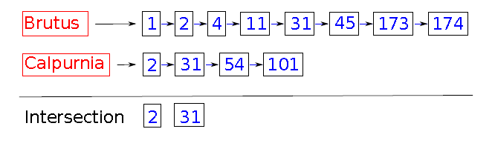
Introduction to Boolean Model
Processing Boolean Queries:
Boolean Query: Brutus AND Calpurnia
Locate the postings lists of both query terms and intersect them.
Note: this only works if postings lists are sorted
Notes:
First, let's define NER!
go through pages, recognize the names of things: "Bill MacCartney", "Stanford University"
the people who came up with this task had a rather precise, philosophically motivated meaning in mind
entity: a discrete, actual thing: Bill MacCartney, but not calcium carbonate or Tuesday or Viagra
named entity: an entity with a name, in a philosophical, Kripke-like sense
(this water bottle is an entity, but not a NAMED entity)
but in practice the definition has been expanded quite a bit in later work
we routinely include dates & times, proteins, drug names
but still, loosely, things that have a name
but NOT references to entities which are not names: "this university", "it”
first task in NER: identifying occurrences of named entities
looking for capital letters is a really good clue! at least in English! but not so much in Hebrew, Chinese, ... non-Latinate alphabets also doesn't really work in German -- all nouns are capitalized!
so that's a pretty useful base-level task -- widely deployed and used
you've probably seen web pages that do this
e.g. financial web sites often mark up stock symbols, names of companies
Microsoft has done work with this, smart tags, entities tagged with metadata
Reuters has web service OpenCalais, you send them docs, they send back NER markup

Slide 17
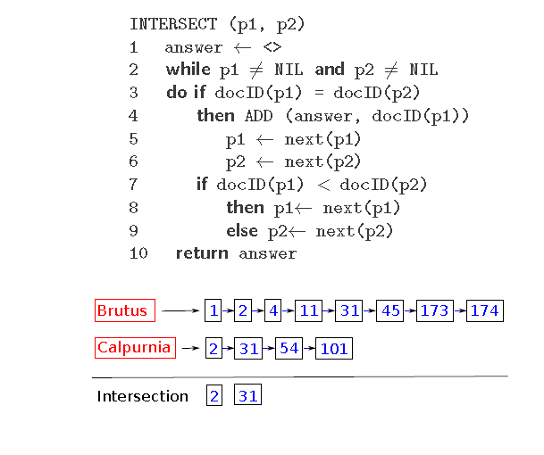
Introduction to Boolean Model
Algorithm for Intersection of two postings:
Notes:
First, let's define NER!
go through pages, recognize the names of things: "Bill MacCartney", "Stanford University"
the people who came up with this task had a rather precise, philosophically motivated meaning in mind
entity: a discrete, actual thing: Bill MacCartney, but not calcium carbonate or Tuesday or Viagra
named entity: an entity with a name, in a philosophical, Kripke-like sense
(this water bottle is an entity, but not a NAMED entity)
but in practice the definition has been expanded quite a bit in later work
we routinely include dates & times, proteins, drug names
but still, loosely, things that have a name
but NOT references to entities which are not names: "this university", "it”
first task in NER: identifying occurrences of named entities
looking for capital letters is a really good clue! at least in English! but not so much in Hebrew, Chinese, ... non-Latinate alphabets also doesn't really work in German -- all nouns are capitalized!
so that's a pretty useful base-level task -- widely deployed and used
you've probably seen web pages that do this
e.g. financial web sites often mark up stock symbols, names of companies
Microsoft has done work with this, smart tags, entities tagged with metadata
Reuters has web service OpenCalais, you send them docs, they send back NER markup

Slide 18
Introduction to Boolean Model
Query Optimization:
Many queries are complex in nature. i.e more terms and operators.
Query Optimization is the process of selecting how to organize the work of answering a query so that the least total amount of work needs to be done by the system.
A major element of this for Boolean queries is the order in which postings lists are accessed.
What is the best order for query processing?
Notes:
First, let's define NER!
go through pages, recognize the names of things: "Bill MacCartney", "Stanford University"
the people who came up with this task had a rather precise, philosophically motivated meaning in mind
entity: a discrete, actual thing: Bill MacCartney, but not calcium carbonate or Tuesday or Viagra
named entity: an entity with a name, in a philosophical, Kripke-like sense
(this water bottle is an entity, but not a NAMED entity)
but in practice the definition has been expanded quite a bit in later work
we routinely include dates & times, proteins, drug names
but still, loosely, things that have a name
but NOT references to entities which are not names: "this university", "it”
first task in NER: identifying occurrences of named entities
looking for capital letters is a really good clue! at least in English! but not so much in Hebrew, Chinese, ... non-Latinate alphabets also doesn't really work in German -- all nouns are capitalized!
so that's a pretty useful base-level task -- widely deployed and used
you've probably seen web pages that do this
e.g. financial web sites often mark up stock symbols, names of companies
Microsoft has done work with this, smart tags, entities tagged with metadata
Reuters has web service OpenCalais, you send them docs, they send back NER markup

Slide 19
Introduction to Boolean Model
Query Optimization:
Notes:
First, let's define NER!
go through pages, recognize the names of things: "Bill MacCartney", "Stanford University"
the people who came up with this task had a rather precise, philosophically motivated meaning in mind
entity: a discrete, actual thing: Bill MacCartney, but not calcium carbonate or Tuesday or Viagra
named entity: an entity with a name, in a philosophical, Kripke-like sense
(this water bottle is an entity, but not a NAMED entity)
but in practice the definition has been expanded quite a bit in later work
we routinely include dates & times, proteins, drug names
but still, loosely, things that have a name
but NOT references to entities which are not names: "this university", "it”
first task in NER: identifying occurrences of named entities
looking for capital letters is a really good clue! at least in English! but not so much in Hebrew, Chinese, ... non-Latinate alphabets also doesn't really work in German -- all nouns are capitalized!
so that's a pretty useful base-level task -- widely deployed and used
you've probably seen web pages that do this
e.g. financial web sites often mark up stock symbols, names of companies
Microsoft has done work with this, smart tags, entities tagged with metadata
Reuters has web service OpenCalais, you send them docs, they send back NER markup

